Slide 1
Self-Adaptive Semi-Autonomous
Parent Selection (SASAPAS)
Each individual has an evolving mate selection function
Two ways to pair individuals:
  Democratic approach
  Dictatorial approach
Notes:
Why semi-autonomous…
The idea is to decentralize the mechanism used to pair individuals for mating. The way we accomplished this was by including an evolving (or adapting) mate selection function in each individual in addition to the candidate solution. We outlined two ways of pairing up individuals using their mate selection functions and for the lack of better words called these methods democratic and dictatorial approaches. In the democratic approach each individual in the population can rate all other individuals based on this mate selection function. Then using these ratings an instance of the stable roommates problem can be created. An instance of the stable roommates problem consists of a set of individuals of even cardinality n. Each individual in the set ranks the remaining n-1 individuals in order of his preference. The object is to find a partition of the set into n/2 pairs of roommates such that no two individuals who are not roommates both prefer each other to their actual roommates. So we can use a solution to the stable roommates problem to pair our individuals for mating. Then during the parent selection stage if an individual is selected for reproduction, then his mate is automatically selected as well. Unfortunately, not every instance of the stable roommates problem has a solution, so in order to make this work we would need to do some tweaking.
Our second, dictatorial, approach is slightly easier. Here if an individual is selected for mating, he becomes a dictator for that moment and is allowed to select whatever mate he wishes. This is the approach we decided to start with mainly because of its ease of implementation. In the paper that we submitted to GECCO 2007 conference we addressed questions of how the mate selection functions are represented, how they are evolved through the generations and reported on our experiments.
Add a slide with diagrams and Cupid

Slide 2








Democratic Approach

Slide 3


Democratic Approach

Slide 4
Dictatorial Approach

Slide 5
Self-Adaptive Semi-Autonomous
Dictatorial Parent Selection (SASADIPS)
Each individual has an evolving mate selection function
First parent selected in a traditional manner
Second parent selected by first parent –the dictator – using its mate selection function
Notes:
Why semi-autonomous…
The idea is to decentralize the mechanism used to pair individuals for mating. The way we accomplished this was by including an evolving (or adapting) mate selection function in each individual in addition to the candidate solution. We outlined two ways of pairing up individuals using their mate selection functions and for the lack of better words called these methods democratic and dictatorial approaches. In the democratic approach each individual in the population can rate all other individuals based on this mate selection function. Then using these ratings an instance of the stable roommates problem can be created. An instance of the stable roommates problem consists of a set of individuals of even cardinality n. Each individual in the set ranks the remaining n-1 individuals in order of his preference. The object is to find a partition of the set into n/2 pairs of roommates such that no two individuals who are not roommates both prefer each other to their actual roommates. So we can use a solution to the stable roommates problem to pair our individuals for mating. Then during the parent selection stage if an individual is selected for reproduction, then his mate is automatically selected as well. Unfortunately, not every instance of the stable roommates problem has a solution, so in order to make this work we would need to do some tweaking.
Our second, dictatorial, approach is slightly easier. Here if an individual is selected for mating, he becomes a dictator for that moment and is allowed to select whatever mate he wishes. This is the approach we decided to start with mainly because of its ease of implementation. In the paper that we submitted to GECCO 2007 conference we addressed questions of how the mate selection functions are represented, how they are evolved through the generations and reported on our experiments.
Add a slide with diagrams and Cupid

Slide 6
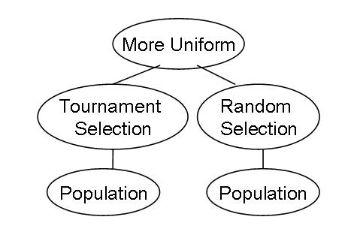
Mate selection function representation
Expression tree as in GP
Set of primitives – pre-built selection methods
Notes:
Mate selection functions were encoded as expression trees as in Genetic programming. In genetic programming a user is required to provide a set of primitives (terminals and non-terminals) from which the expression trees will be constructed. Our set of primitives contained one terminal – Population and several non-terminals. Non-terminals were pre-built selection methods that either selected one individual from a collection of individuals, selected a subset of individuals from a collection of individuals, or selected one individual from two individuals. It was required that the expression tree would return one individual. An example or a randomly initialized mate selection function is shown on the slide. Here the primitive “more uniform” takes two individuals with bitstring candidate solutions (for example 010101 and 000111) and returns the one that has a more uniform bitstring.

Slide 7
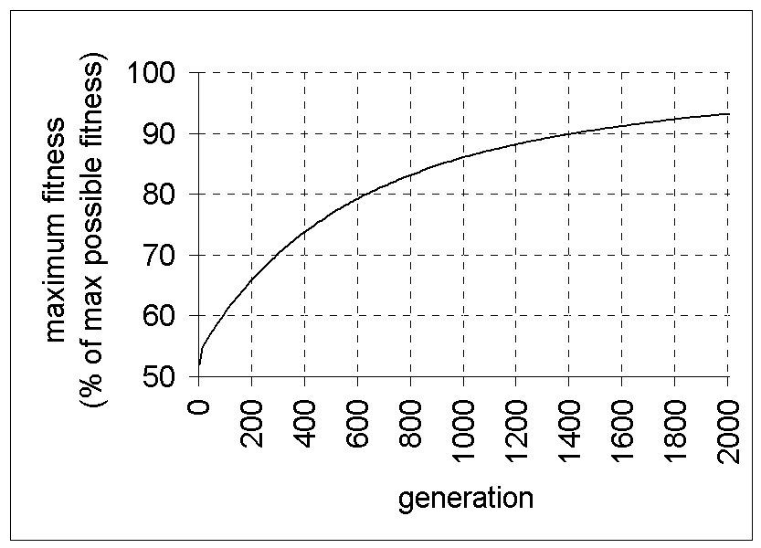
Mate selection function evolution
Let F be a fitness function defined on a candidate solution. Let
improvement(x) = F(x) – max{F(p1),F(p2)}
Max fitness plot; slope at generation i is s(g_{i})
Notes:
Randomly initialized mate selection functions go through the evolutionary process together with the candidate solutions of the individuals. We would like to keep good mate selection functions and discard the bad ones. To determine how good a particular mate selection function is will look at the fitness of the child that was produced from the pairing of individuals that produced by that mate selection function. When a child candidate solution is created that child also needs to obtain his own mate selection function because he may become the dictator in the future. There are several options for obtaining a child’s mate selection function such as randomly create one, copy one of the parents’ mate selection function or use recombination of expression trees. Since we want the child to have a good mate selection function, randomly creating one is not a good option, while the other two options seem to make sense. To decide how a mate selection function is obtained we defined improvement of a child as the difference between that child’s fitness and the fitness of the better parent. Essentially, if the improvement of a child is large then the mate selection function was good and it is best to copy the mate selection function that resulted in such pairing. Otherwise we will use recombination followed by a chance of mutation to obtain the mate selection function. The question now becomes, what is a big improvement. We used the slope of the maximum fitness curve to answer this question. If we plot the fitness of the best individual in each generation in a typical EA the slope of such plot will be steep in the early generations and will decrease in the later ones. We would like to keep the slope steep for as long as possible, thus increasing the fitness faster. Using this idea, improvement was decided to be big if it was greater than or equal than the slope of the maximum fitness plot.

Slide 8
Mate selection function evolution
IF improvement(offspring)>s(g_{i-1})
  Copy first parent’s mate selection function (single parent inheritance)
Otherwise
  Recombine the two parents’ mate selection functions using standard GP crossover
  (multi-parent inheritance)
  Apply a mutation chance to the offspring’s mate selection function
Notes:
This slide basically summarizes our mate selection function evolution method.

Slide 9
Experiments
Counting ones
4-bit deceptive trap
  If 4 ones => fitness = 8
  If 3 ones => fitness = 0
  If 2ones => fitness = 1
  If 1 one => fitness = 2
  If 0 ones => fitness = 3
SAT
Notes:
We compared our EA with self-adaptive semi-autonomous parent selection to a regular EA on three test problems: counting ones, 4-bit deceptive trap, and SAT. Counting ones is a toy problem with a very simple fitness function. The solution to the counting ones problem of length N is a string of N 1’s. So the fitness can be defined as the number of ones in the string.
The solution the 4-bit deceptive trap problem of length N is also N ones, but the fitness function of this problem is a lot more complicated. A bit string is split into consecutive substrings (or traps) of length 4. The fitness of a candidate solution is the sum of the fitnesses of each trap. The fitness of a trap is defined as outlined here. Such fitness function has many local optima so the global optimum is hard to reach. Finally, SAT is the well known boolean satisfiability problem in conjuctive normal form. The fitness of a candidate solution to a SAT instance was defined as the number of causes satisfied by the given truth assignment.

Slide 10
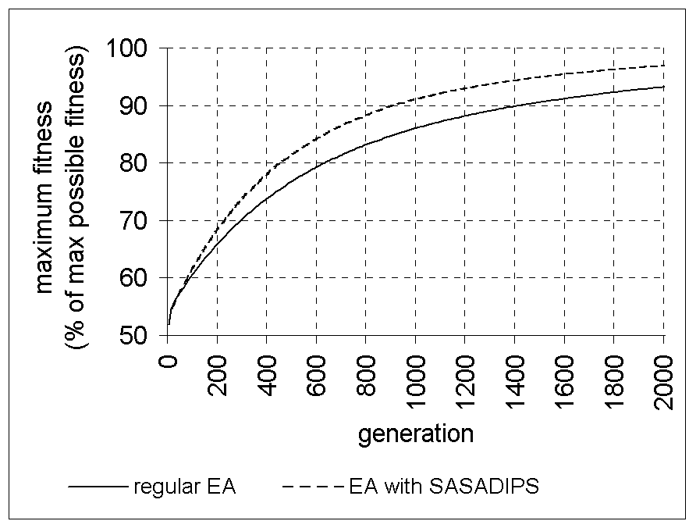
Counting ones results
Notes:
We compared the maximum fitness of the regular EA versus the maximum fitness of the EA with SASADIPS at the end of the experiments. For counting ones problem EA with SASADIPS outperformed the regular EA. If we look at the maximum fitness plot of each EA, as shown here, we can see that the slope of the plot remains steep for the EA with SASADIPS longer than for the regular EA.

Slide 11
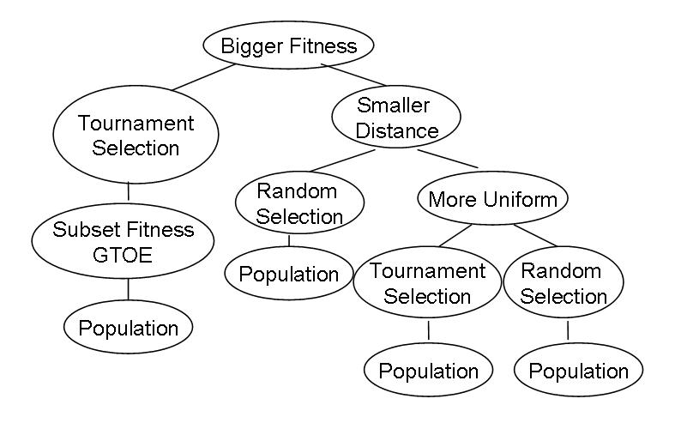
Highly evolved mate selection function
Notes:
Here is an example of a mate selection function at the end of the experiments with the counting ones problem. This is just one example of it. This particular mate selection function has a high selection pressure because it uses primitives “bigger fitness” (thus selecting a fitter individual out of the given two) and a primitive “subset fitness GTOE” – this primitive extracts a subset of individuals whose fitness is greater than or equal to the fitness of the owner of this mate selection function.

Slide 12
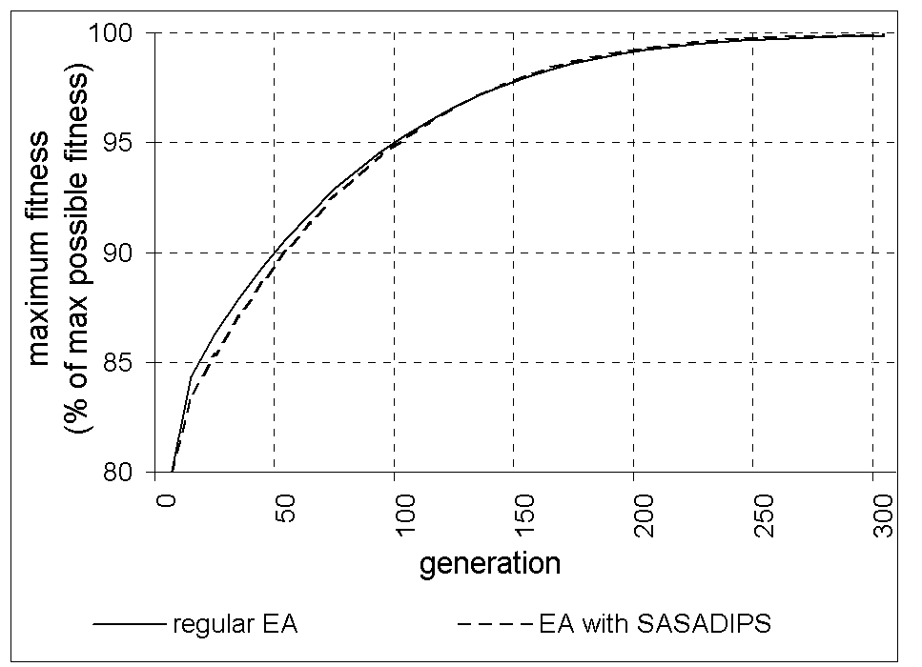
SAT results
Notes:
In the case of SAT the advantage of the EA with SASADIPS over the regular EA is not as obvious, but in fact EA with SASADIPS does outperform the regular EA.

Slide 13
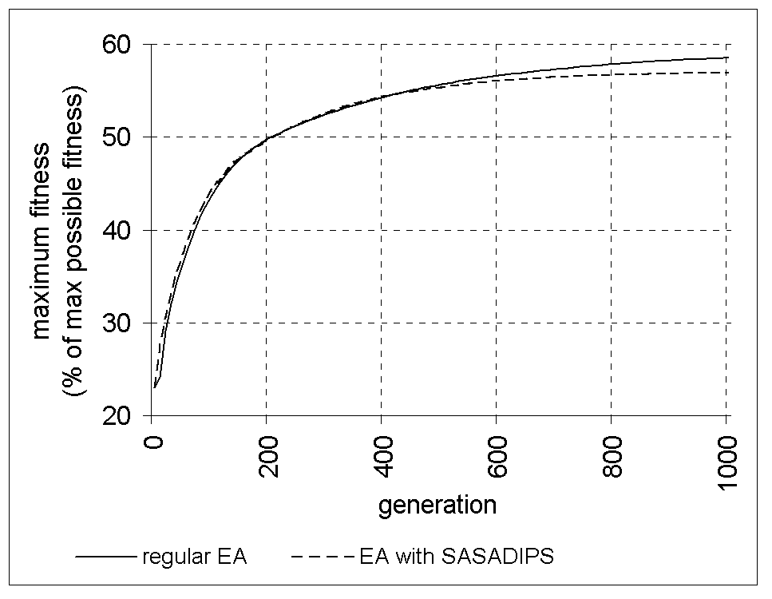
4-bit deceptive trap results
Notes:
Finally, on the 4-bit deceptive trap problem EA with SASADIPS performed worse than the regular EA. You can see on this plot that the EA with SASADIPS does well until about generation 400 after which its performance declines. This was a somewhat unexpected result considering how well our EA with SASADIPS did on the counting ones problem. Also, the parent selection method that was used in the regular EA (tournament selection) was one of the primitives given to the EA with SASADIPS, so our EA with SASADIPS has the tools to perform no worse than the regular EA. In either case this result shows that there is some problem with our EA with SASADIPS. Having gotten such result we hypothesized about what went wrong.

Slide 14
SASADIPS shortcomings
Steep fitness increase in the early generations may lead to premature convergence to suboptimal solutions
Good mate selection functions hard to find
Provided mate selection primitives may be insufficient to build a good mate selection function
New parameters were introduced
Only semi-autonomous
Notes:
One possible problem with EA with SASADIPS is that steep fitness increase in the early generations my lead to premature convergence to suboptimal solutions. It is possible that this is what happened in the case of the 4-bit deceptive trap problem. The population quickly converged to a suboptimal solution and it was hard for our EA with SASADIPS to get out of that local optimum and move towards the global one. So greedily improving the fitness on the short term basis might not be the best strategy in the long run. One way to deal with this problem could be to have multiple populations that evolve independently but every once in a while swap individuals.
Another possible problem with the EA with SASADIPS is that good mate selection functions could be hard to find. Even though the EA with SASADIPS has access to the parent selection method used by the regular EA, it might not choose that parent selection method, even if that method is the best choice. If this is the reason why EA with SASADIPS did worse than the regular EA, one way to cope with this problem would be with what I call “reset mutation”. Reset mutation resets the parent selection function of an individual to the parent selection method used by the regular EA (tournament selection in our case). A chance of reset mutation could be applied to the individuals whose mate selection function had negative improvement.
There are definitely many avenues for improving this method. Decentralizing mate selection makes sense from the nature point of view and our results show that in some cases it is beneficial. The main problem with EA’s is that they are hard to properly configure and it appears from the existing research that self-adaptation is a good way to take the burden of specifying parameters off the users. We used the principles of self-adaptation to take the burden of specifying parent selection operator off the users. Although our results are not perfect they show the potential that it can be done.

Slide 15
Greedy Population Sizing
(GPS)

Slide 16
The parameter-less GA
Evolve an unbounded number of populations in parallel
Smaller populations are given more fitness evaluations
Fitness evals
|P₁| = 2|P₀|
…
|P_{i+1}| = 2|P_{i}|
P₀
P₁
P₂
Terminate smaller pop. whose avg. fitness is exceeded by a larger pop.

Slide 17
Greedy Population Sizing
F₄
F₃
Fitness evals
F₂
Evolve exactly two populations in parallel
Equal number of fitness evals. per population
F₁
P₀
P₁
P₂
P₃
P₄
P₅

Slide 18
GPS-EA vs. parameter-less GA
Parameter-less GA
2N
2F₁ + 2F₂ + … + 2F_{k} + 3N
2F₄
GPS-EA
F₁ + F₂ + … + F_{k} + 2N
N
N
N
2F₃
F₄
F₃
2F₂
F₄
N
2F₁
F₂
F₃
F₁
F₁
F₂

Slide 19
GPS-EA vs. the parameter-less GA, OPS-EA and TGA
Deceptive Problem
GPS-EA < parameter-less GA
TGA < GPS-EA < OPS-EA
GPS-EA finds overall better
solutions than parameter-less GA

Slide 20
Limiting Cases
F_{avg}(P_{i+1})<F_{avg}(P_{i})
No larger populations are created
No fitness improvements until
termination
Approx. 30% - limiting cases
Large std. dev., but lower MBF
Automatic detection of the limiting
cases is needed

Slide 21
GPS-EA Summary
Advantages
  Automated population size control
  Finds high quality solutions
Problems
  Limiting cases
  Restart of evolution each time

Slide 22
Estimated Learning Offspring Optimizing
Mate Selection
(ELOOMS)

Slide 23
Traditional Mate Selection
5
3
8
2
4
5
2
MATES
t – tournament selection
t is user-specified
5
4
5
8

Slide 24
ELOOMS
YES
YES
YES
MATES
NO
YES
NO
YES

Slide 25

Mate Acceptance Chance (MAC)
d₁ d₂ d₃ … d_{L}
How much do I like ?
k
j
b₁ b₂ b₃ … b_{L}

Slide 26
Desired Features
d₁ d₂ d₃ … d_{L}
j
b₁ b₂ b₃ … b_{L}
# times past mates’ b_{i} = 1 was used to produce fit offspring
# times past mates’ b_{i} was used to produce offspring
Build a model of desired potential mate
Update the model for each encountered mate
Similar to Estimation of Distribution Algorithms

Slide 27
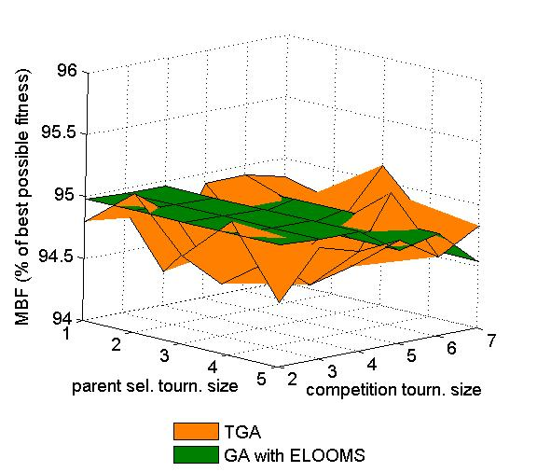
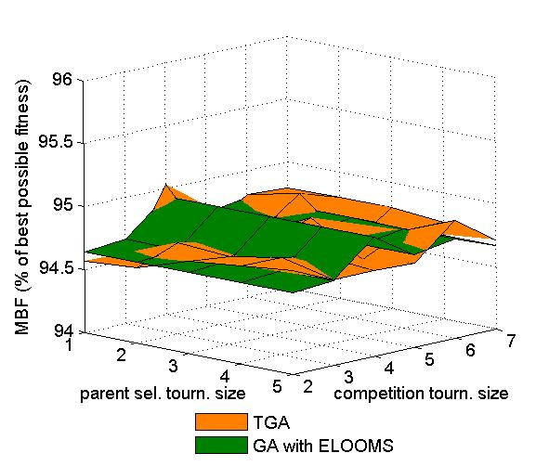
ELOOMS vs. TGA
Easy Problem
L=500
With Mutation
L=1000
With Mutation

Slide 28
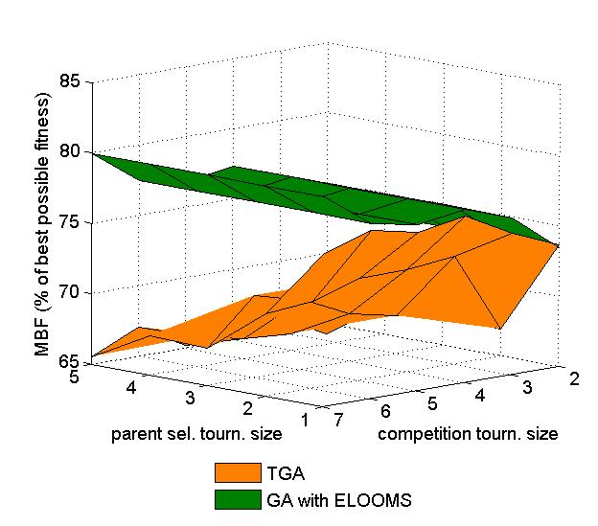
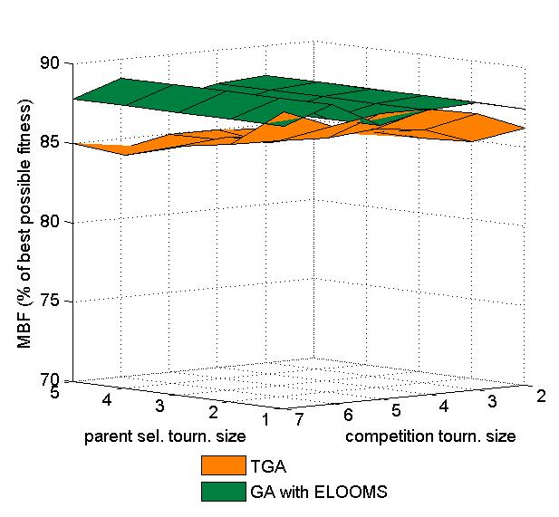
ELOOMS vs. TGA
Deceptive Problem
L=100
Without Mutation
With Mutation

Slide 29
Why ELOOMS works on Deceptive Problem
More likely to preserve optimal structure
1111 0000 will equally like:
  1111 1000
  1111 1100
  1111 1110
But will dislike individuals not of the form:
  1111 xxxx

Slide 30
Why ELOOMS does not work as well on Easy Problem
High fitness – short distance to optimal
Mating with high fitness individuals – closer to optimal offspring
Fitness – good measure of good mate
ELOOMS – approximate measure of good mate

Slide 31
ELOOMS computational overhead
L – solution length
μ – population size
T – avg # mates evaluated per individual
Update stage:
  6L additions
Mate selection stage:
  2L*T* μ additions

Slide 32
ELOOMS Summary
Advantages
  Autonomous mate pairing
  Improved performance (some cases)
  Natural termination condition
Disadvantages
  Relies on competition selection pressure
  Computational overhead can be significant

Slide 33
GPS-EA + ELOOMS Hybrid

Slide 34
Expiration of population P_{i}
If F_{avg}(P_{i+1}) < F_{avg}(P_{i})
  Limiting cases possible
If no mate pairs in P_{i} (ELOOMS)
  Detection of the limiting cases

Slide 35
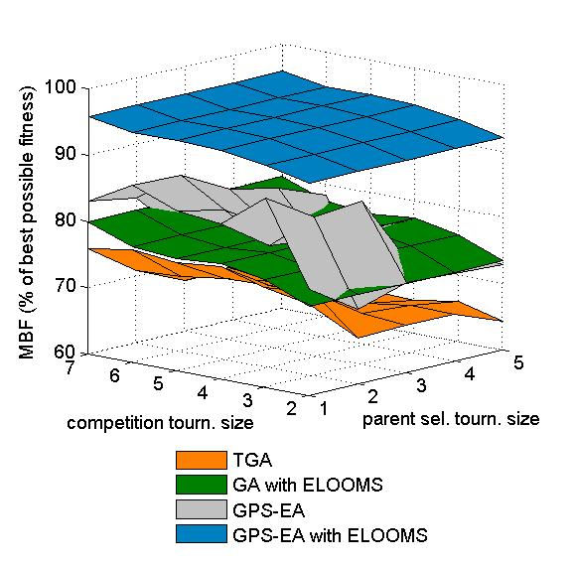
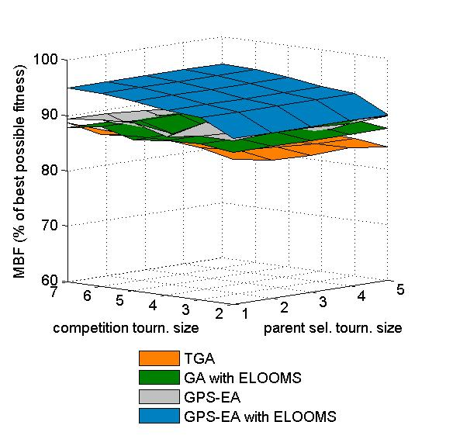
Comparing the Algorithms
Deceptive Problem
L=100
Without Mutation
With Mutation

Slide 36
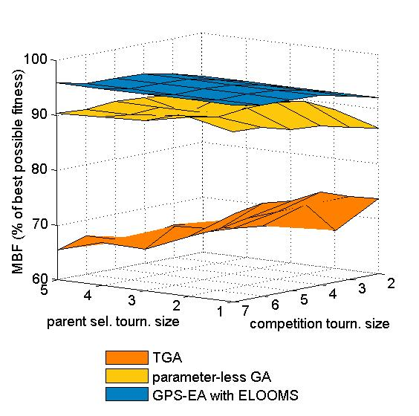
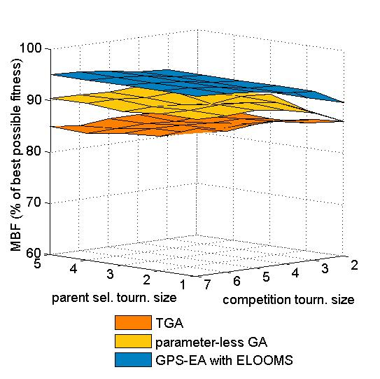
GPS-EA + ELOOMS vs. parameter-less GA and TGA
Deceptive Problem
L=100
Without Mutation
With Mutation

Slide 37
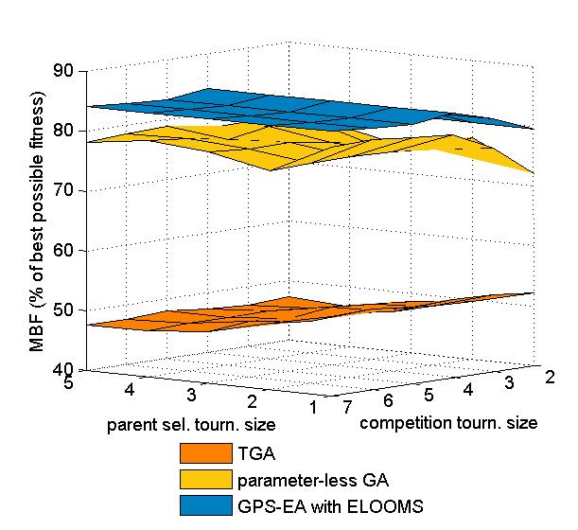
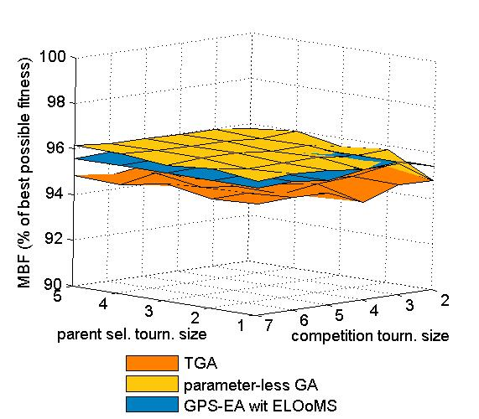
GPS-EA + ELOOMS vs. parameter-less GA and TGA
Easy Problem
L=500
Without Mutation
With Mutation

Slide 38
GPS-EA + ELOOMS Summary
Advantages
  No population size tuning
  No parent selection pressure tuning
  No limiting cases
  Superior performance on deceptive problem
Disadvantages
  Reduced performance on easy problem
  Relies on competition selection pressure

